Slide 1
Running a C program on Flip server with SSH Secure Shell client
CS 261

Slide 2
Install the software
INSTALLING SSH SECURE SHELL CLIENT
1. Download the client, SSH Secure Shell Client 3.2.9, from https://shareware.unc.edu. Remember where you've saved it. 2. Click on the icon to install the client. 3. At the Welcome window, click Next. 4. At the License Agreement window, click Yes. 5. At the Choose Destination Folder window, click Next . 6. At the Select Program Folder window, click Next. 7. At the Select Components window, click Next. 8. At the Check Setup Information window, click Next. 9. When the Setup Status is complete, click Finish.

Slide 3
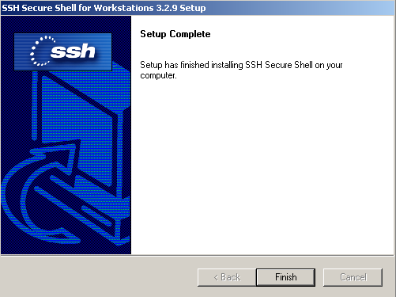

Slide 4
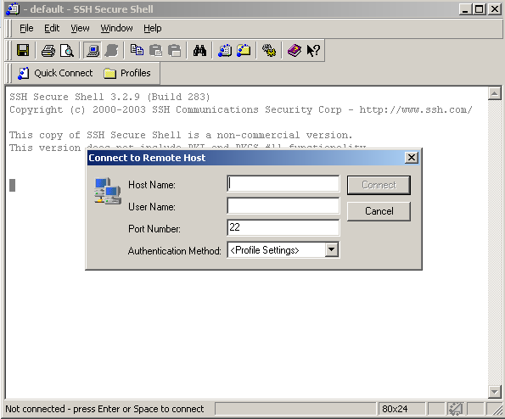
Connect
or
Choose Quick connect
Notes:
Use file ->quick connect or the quick connect shortcut shown outside.

Slide 5
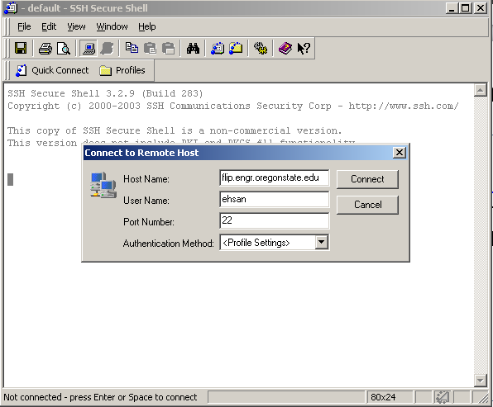
Connect
Type in your host name (flip.engr.oregonstate.edu). 3. Type in your user name. (engineering name) 4. Make sure the Port Number is 22.

Slide 6
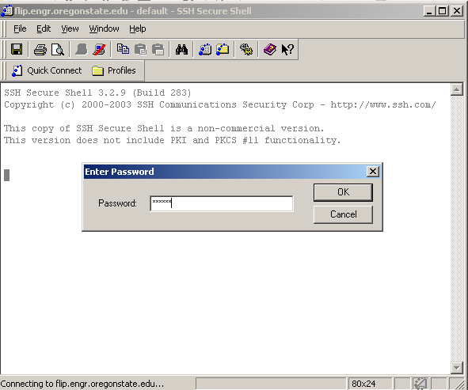
Connect
Give your engineering password. After that you will be connected.

Slide 7
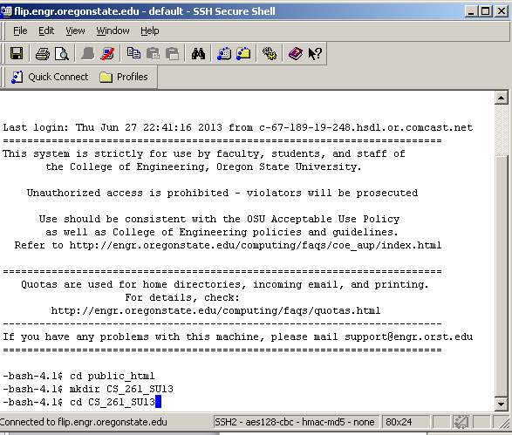
Unix command to create class directory
Change to public_ html ( command: cd public_html)
Create a directory for CS-261 ( command: mkdir CS_261_SU13)
Change your working directory to CS_261_SU13 ( command: cd CS261_SU13)

Slide 8
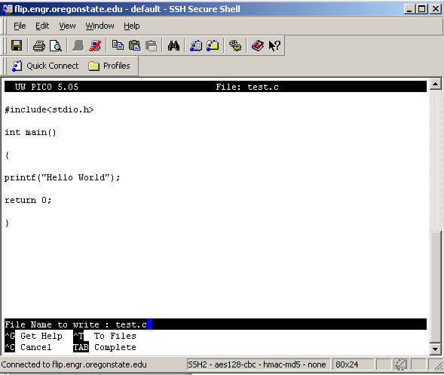
Write your C program
Open a file with any editor ( command: pico test.c) , which is a Unix like Notepad.
Write you first c program there .
Save it – CTRL+ o
Exit – CTRL+x

Slide 9
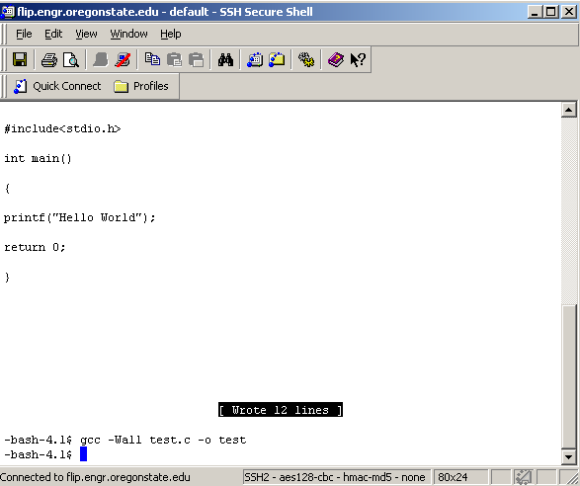
Compile
Now compile ( command:)
gcc –Wall test.c –o test ( the commands are case- sensitive)
Notes:
To know how the command works – see the GCC tutorial in the course resource folder.

Slide 10
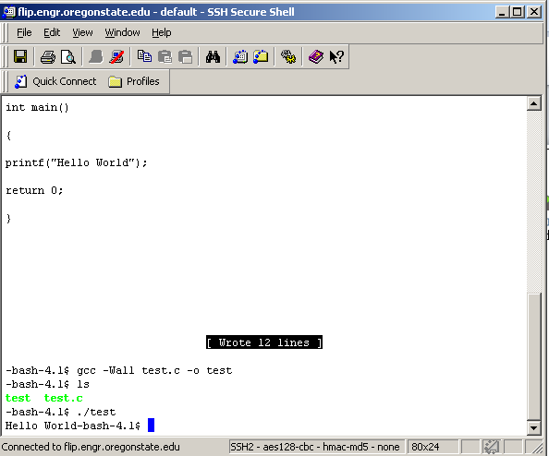
Run
Execute with the command ./test

Slide 11
Transferring file from local computer to remote server
Click on the yellow New File Transfer window icon.

Slide 12
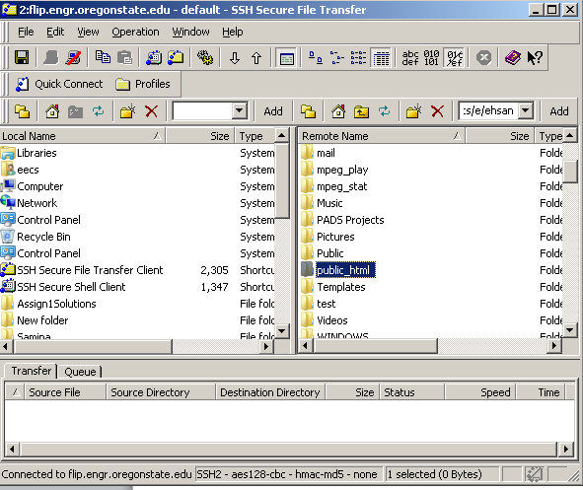
Transferring file from local computer to remote server
Your local files will be in the window on the left, the remote server files in the window on the right. You can either drag and drop folders or files from one side to the other to transfer files, or highlight a file or folder and use the Get and Put arrows at the top (Get to place files from the remote server into a local folder, and Put to post files from your local folders onto the remote server.)

Slide 13
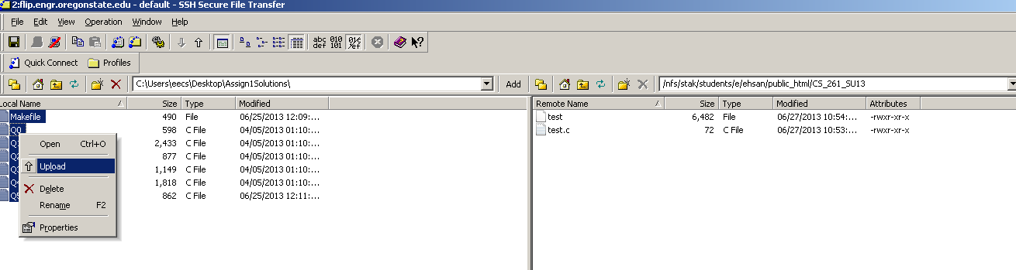
Transferring file from local computer to remote server
Upload the files to correct destination folder
Notes:
Navigate to the folder that you have created for the class.

Slide 14
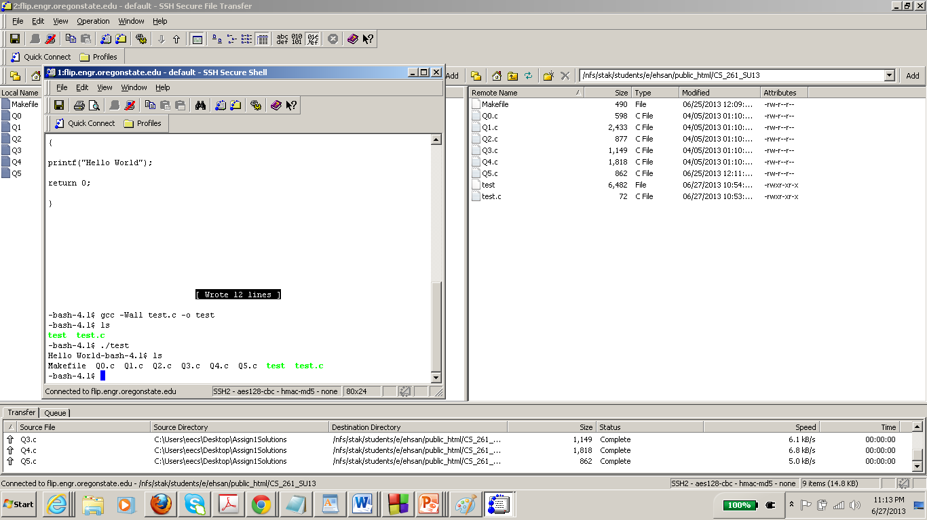
Transferring file from local computer to remote server
You can now see the files on directory
Notes:
The uploaded files will be visible on the directory . Use ls command to check it.

Slide 15
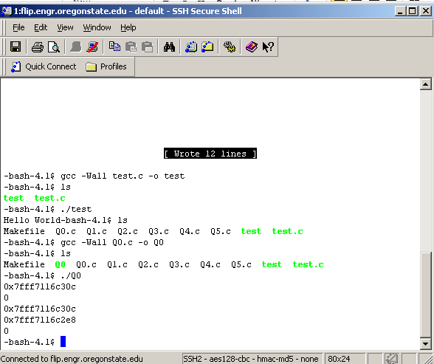
Now you can compile and run the .c files with the same command that we have used before.
Notes:
To run multiple C files at the same time we use the Makefile. It is a script file . You can open it with pico Makefile . And can see commands for compiling all the files together are given there. Try it. Use the command
Make
and then execute one by one .

